Slide 1
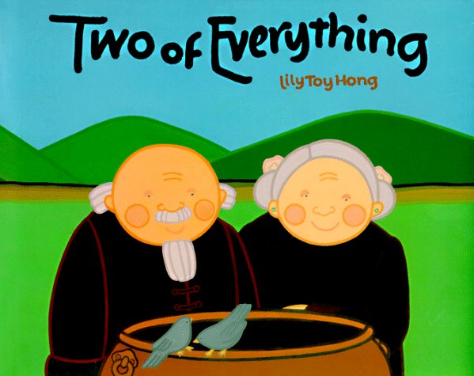
Vocabulary Intro

Slide 2
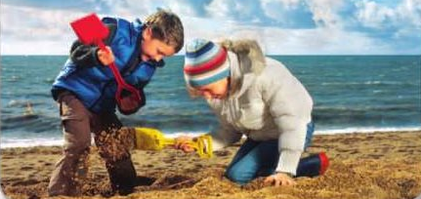
search
If you search for someone or something, you look carefully for that person or thing.
It is fun to search for buried treasure. You never know what you will find!
When have you had to search for something or someone?

Slide 3
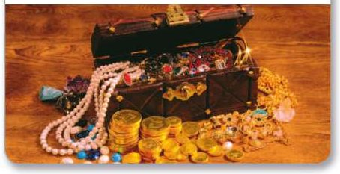
contained
Something that is contained is held or kept inside.
This old box contained jewels, coins, and other treasures.
What is contained in your backpack?

Slide 4
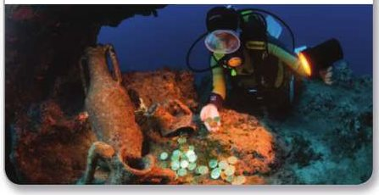
startled
A person is startled when he or she is shocked or surprised by something that happens suddenly.
The diver was startled to find treasure at the bottom of the ocean.
When have you been startled?

Slide 5
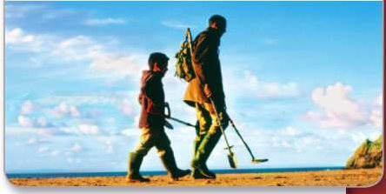
odd
Something that is odd is strange or unusual.
Do you think it is odd, or strange, to look for buried tresure?
What animal do you think is odd?

Slide 6
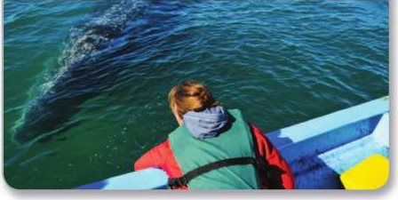
leaned
When you leaned in a direction, you bent your body in that direction.
The woman leaned over to get a better view of the whale near the ship.
Have you ever leaned so far in one direction that you fell over?

Slide 7
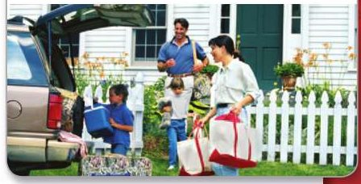
tossed
If you tossed something, you threw it lightly.
They tossed the supplies into the trunk to pack for their vacation.
What have you tossed before?

Slide 8
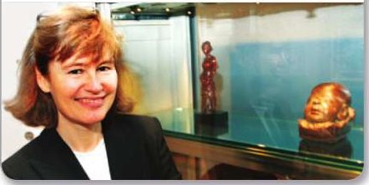
grateful
When you are grateful for something good that has happened, you feel pleased and thankful.
The museum was very grateful, or thankful, to get the old statues.
What are you grateful for?

Slide 9
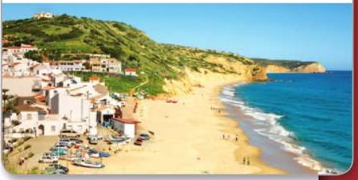
village
A village is a group of houses and buildings in a country area.
This village is near the ocean. People find coins buried on the beach.
Put these in order, smallest to biggest, by how many people live in each one:
village house city town

